Slide 1
CYCU Instant Information Broker
10627110 王昱凱
10627211 林佑任
10627217 張哲睿
Advisor：吳宜鴻 Yi-Hung Wu

Slide 2
WHY?

Slide 3
How we get the campus information in daily?

Slide 4
itouch
ilearning
Gmail
Facebook
Line Group

Slide 5
itouch VS Line Group

Slide 6
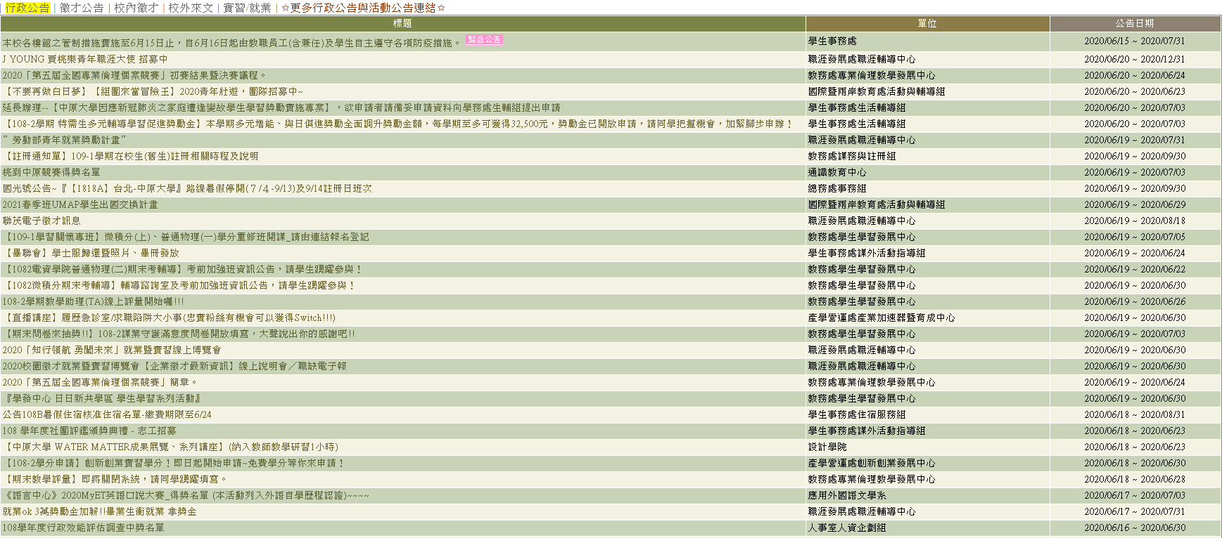

Slide 7
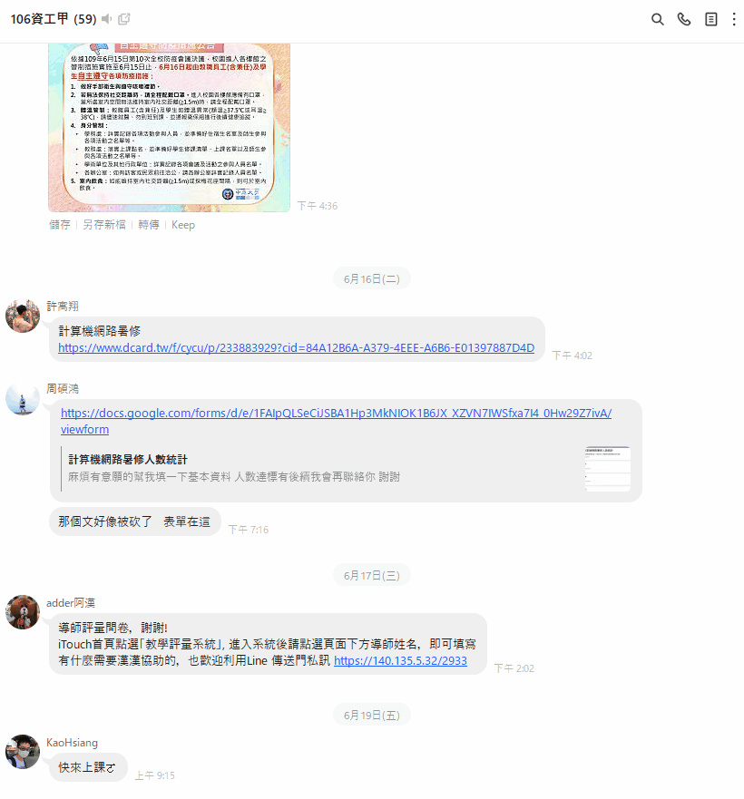
Notes:
Which is simpler and easier to understand than the previous one.

Slide 8
Which UI do you prefer ? どっち?

Slide 9
Besides itouch

Slide 10
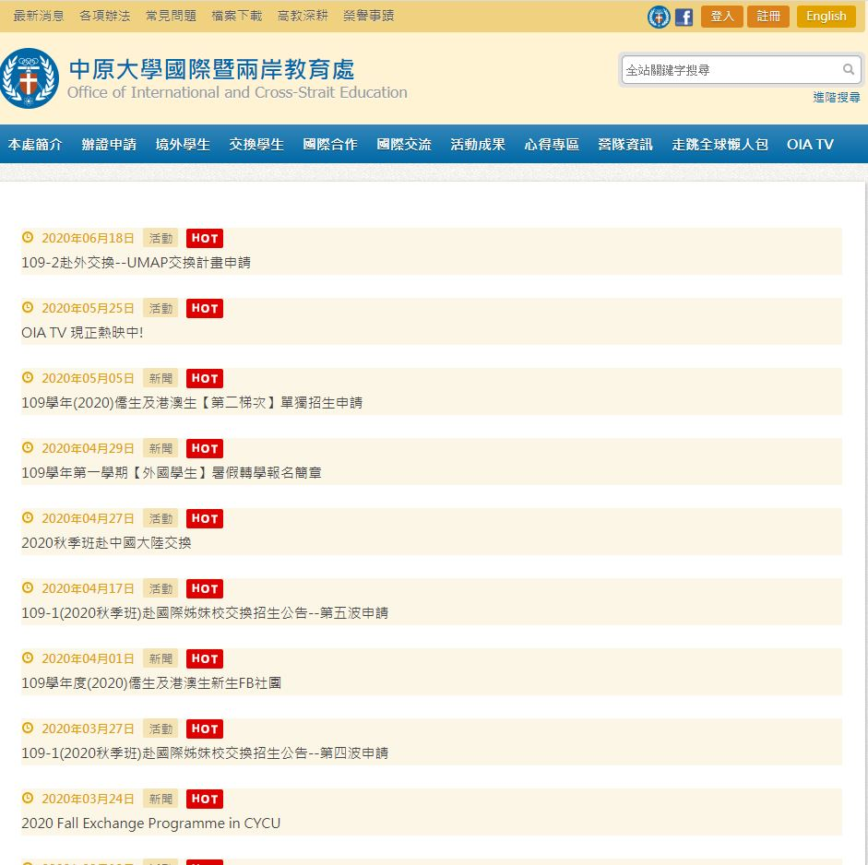
Exchange student info

Slide 11
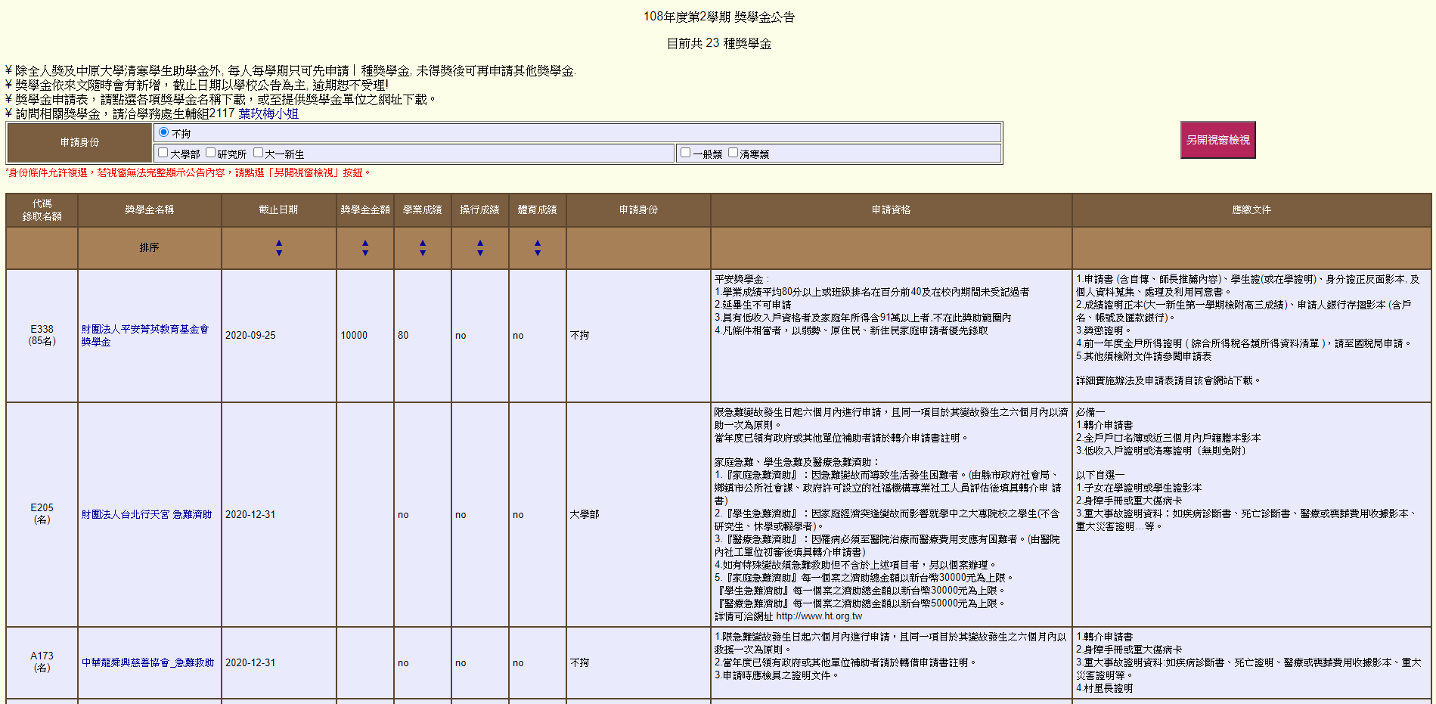
Scholarship info
Notes:
You can hardly get what you want right away cause there are so many details.

Slide 12
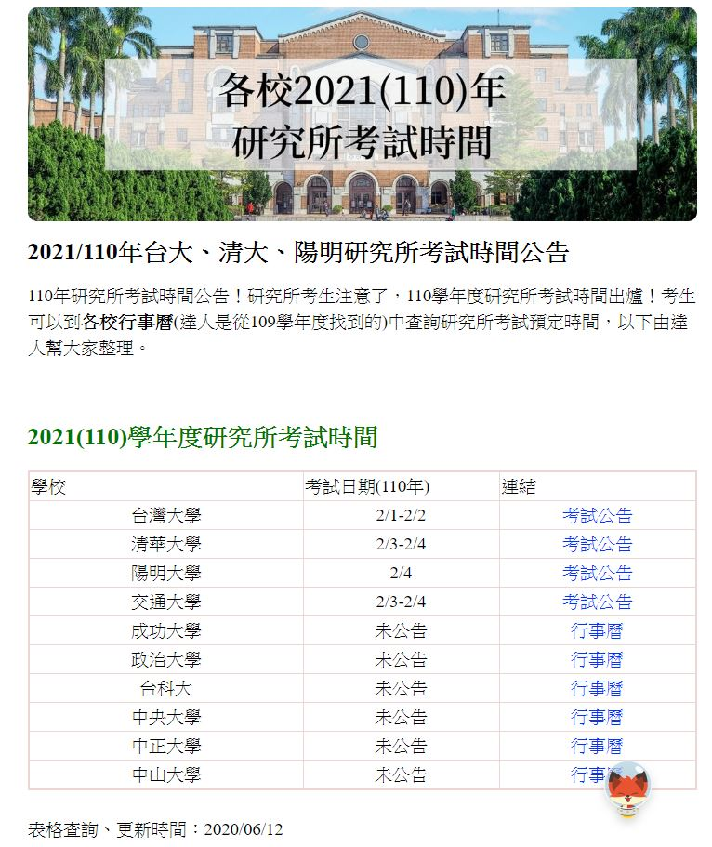
Exam info

Slide 13
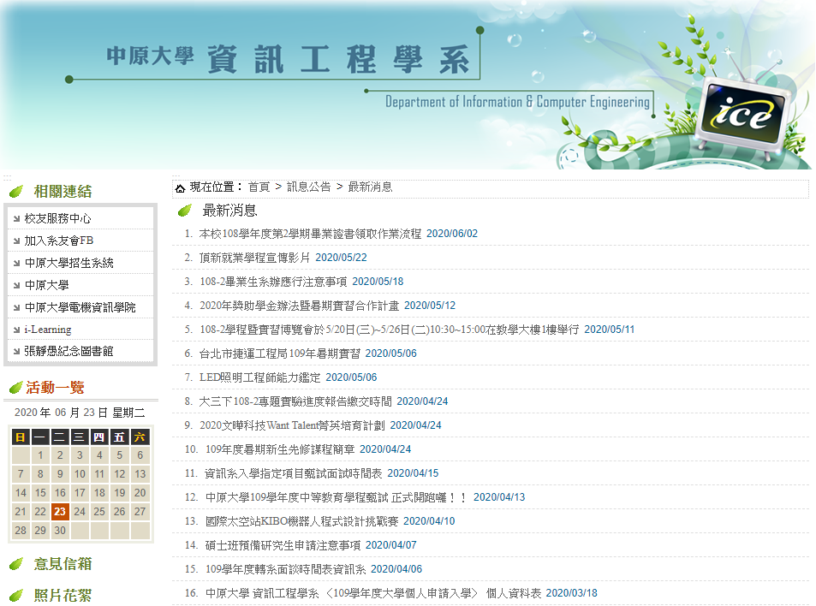
CYCU ICE info
Notes:
Our department's info

Slide 14
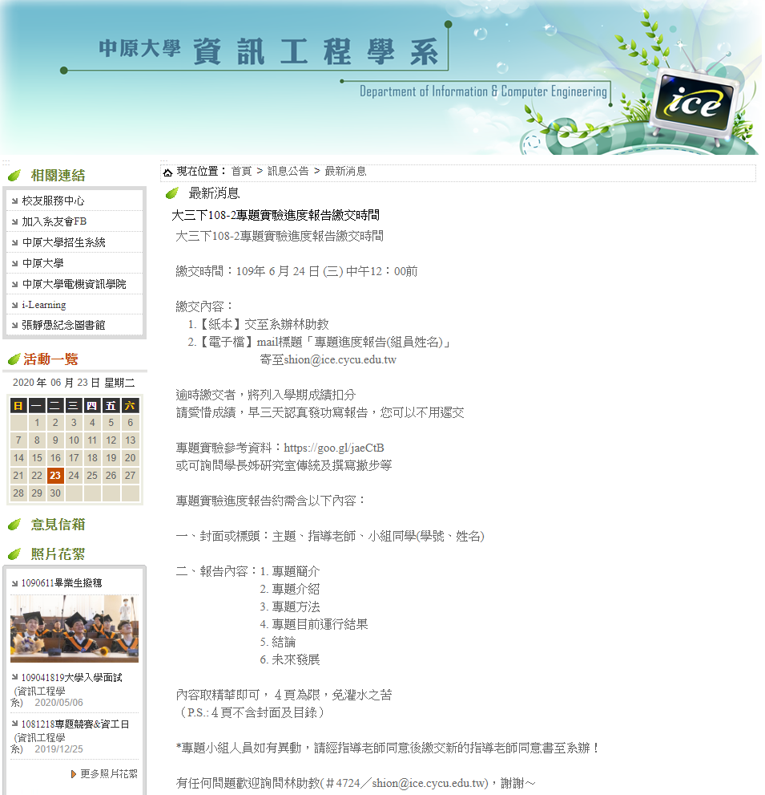
Notes:
Which you can see, there was a report we should submit today, but probably less of you knew it.

Slide 15
Information is too much to get.

Slide 16
Integrate and analyze
LINE
itouch
Exchange student
Scholarship
CYCU ICE
Exam
Notes:
What we are going to do is to …

Slide 17
HOW?

Slide 18




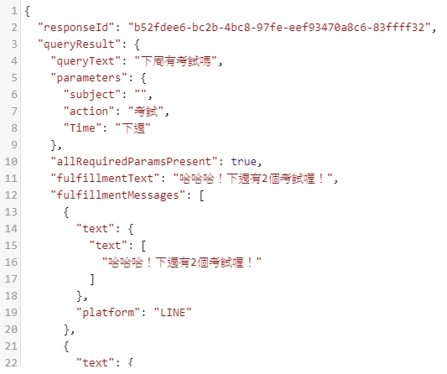



Slide 19
Future

Slide 20
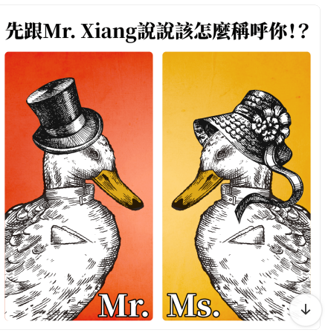
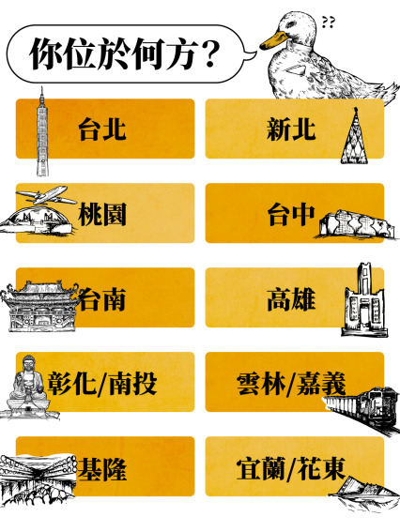

Slide 21
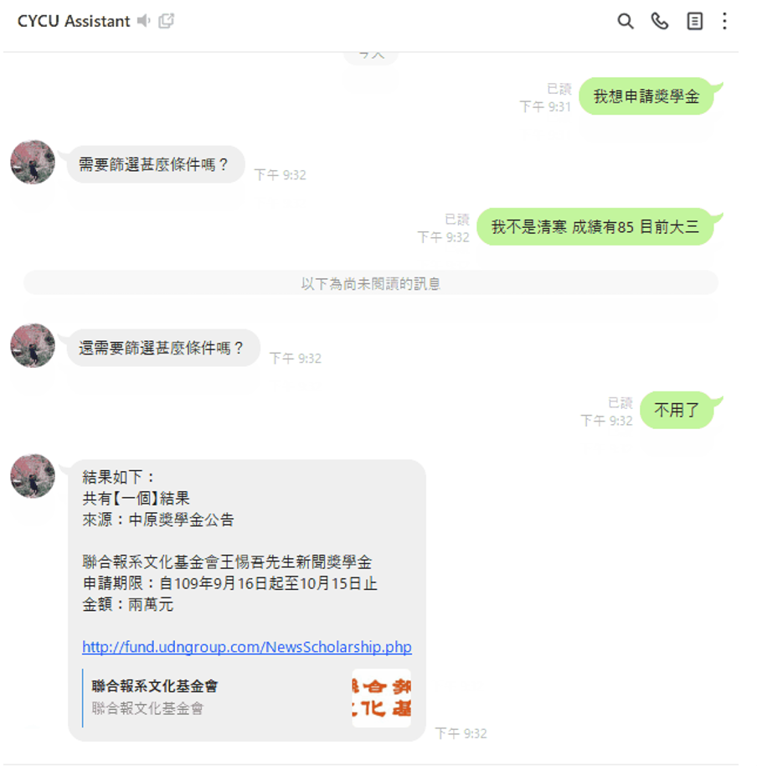

Slide 22

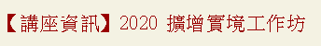

Slide 23

Thanks for your attention

